Slide 1
DSI Project 2
Regression Challenge
Ng Jun Kang

Slide 2
Problem Statement
Create a regression model to predict housing sales price
Build based on Ames Iowa housing dataset
Explore and discover which variables are the good predictors for price estimation

Slide 3
Modeling Process
EDA to explore the relation between the variables and select predictors
Perform deductive imputation on data for selected predictors
Polynomial expansion on numerical features
One-hot encoding on categorical variables
Train/test split on ‘train.csv’
Model selection through cross-validation
Model fitting on entire ‘train.csv’ dataset
Data preparation for ‘test.csv’ dataset
Prediction and Kaggle submission

Slide 4
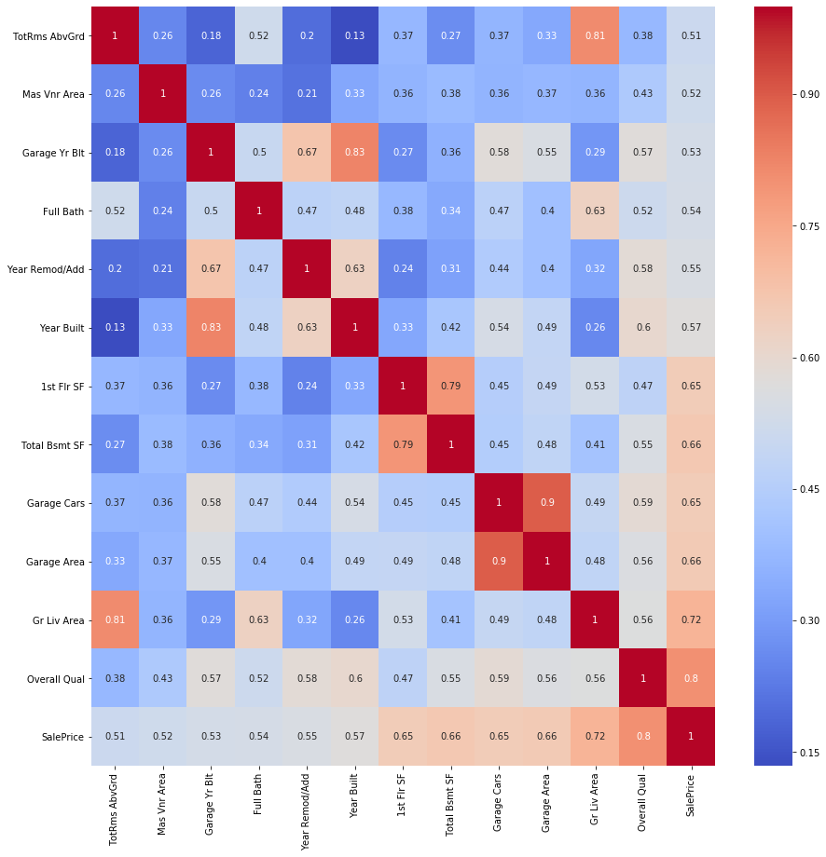
EDA: Relation between Numerical Predictors

Slide 5
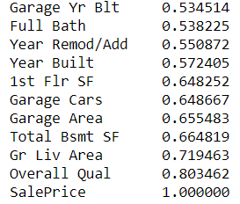
EDA: Selected Numerical Predictors

Slide 6
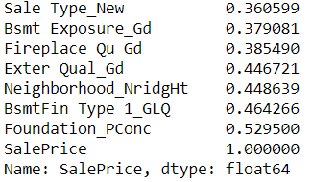
EDA: Selected Categorical Predictors

Slide 7
Model CV Scoring and Selection
The Cross-Validation RMSE and R2 score of the respective models are as follow:
Linear Regression: 28,332 and 0.88
Lasso: 28,105 and 0.88
Ridge: 28,244 and 0.88
Elastic Net: 29,682 and 0.87
Lasso is selected as it has the lowest RMSE and comparable R2 score

Slide 8
Model Workflow
Ames Iowa Housing Dataset (test.csv)
Prediction
(Predicted Sale Price)
Polynomial Features
Data Cleaning
Scaling
Lasso
Encoding

Slide 9
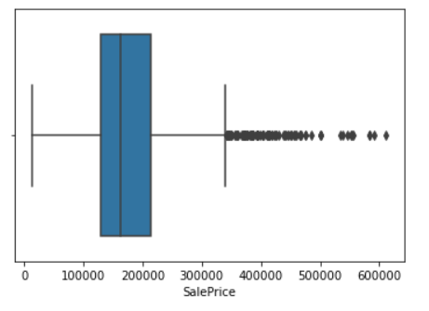
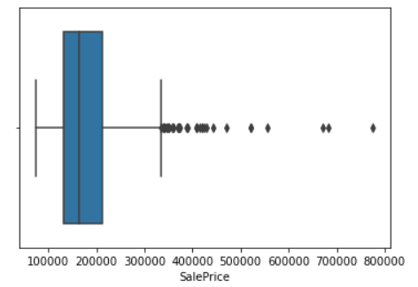
Model Results
The RMSE for the model are as follow:
`train.csv`: 24662 (Model Fitting score)
`test.csv`: 26927 (Kaggle score)
We see that the RMSE difference is less than 10% between seen and unseen data, and therefore can say that the developed model is well-fitted

Slide 10
Inference and Conclusion
We observed that the better numerical and categorical predictors are ['Full Bath’, 'Year Built’, 'Total Bsmt SF’, 'Garage Area’, 'Gr Liv Area’, 'Overall Qual'] and ['Foundation','BsmtFin Type 1'] respectively.
Surprisingly, 'Lot Size', which is more common and intuitive, does not have a very strong relationship with ‘SalePrice’ as compared to above, and did not yield good prediction results.

